Slide 1
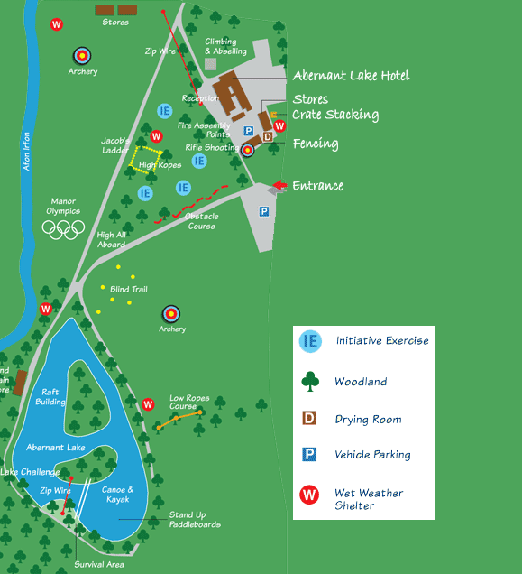
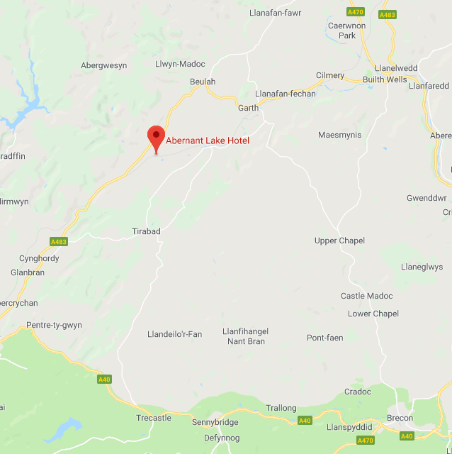
Manor Adventure
2019 - Year 6

Slide 2
The purpose of the residential trip
To further develop the children's confidence and relationships in a secure and nurturing environment.
To provide the children with experiences and activities that they may not have experienced before
To further develop children's independence and self-reliance skills.

Slide 3
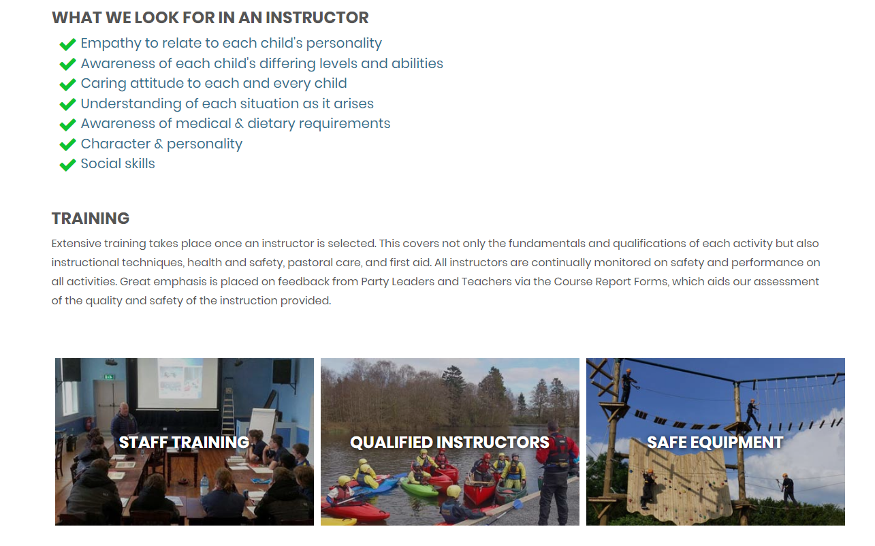
Safety and security

Slide 4
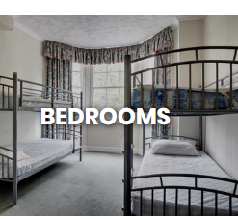
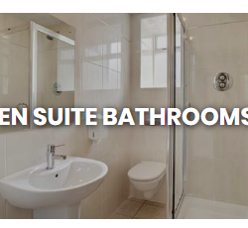
Bedroom Facilities
All Marlborough pupils and staff situated along one corridor.
Bedrooms sleep 4-6
All bedrooms are ensuite.
Staff bedrooms at the end of each corridor and in the middle.
Boys and girls grouped together.

Slide 5
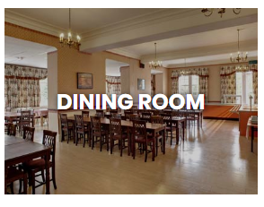
Mealtimes
Dining hall for both pupils and staff.
Children will eat together as a school.
Excellent quality and variety of food at mealtimes.
All dietary requirements are catered for.

Slide 6
7.30 Wake up call
8.00 – 9.00 Breakfast
9.00 – 10.30 Outdoor Activity 1
10.30 – 10.50 Beak Time
10.50 – 12.20 Outdoor Activity 2
12.20 – 13.40 Lunch Time
13.40 – 15.10 Outdoor Activity 3
15.10 – 15.30 Break Time
15.30 – 17.00 Outdoor Activity 4
17.15 – 19.00 Evening Meal / Free Time
19.00 – 20.30 Outdoor Activity 5
21.30 Bedtime
Structure
of the
Day

Slide 7
Activities
Hill walk
Low-level cycling
Open canoe
Abseiling
Archery
Video
0pen kayaking
Climbing
Blind trail
Fencing
Disco
Lake Challenge
Obstacle course
Survival skills
Stand up paddle board
Zip Wire

Slide 8
What the children will need
What to pack
Spending money
Medical needs

Slide 9
What parents need to know
Keeping in touch
Departure and arrival
Home sickness
Any questions?

